Slide 1
BHOJ REDDY ENGINEERING COLLEGE FOR WOMEN
DEPARTMENT OF INFORMATION TECHNOLOGY
IV BTECH I.SEM.A SEC MINI PROJECT REVIEW
Academic year 2020-2021 Date:22-01-2021
MENTORING STARTUPS
PRESENTED BY
CH.AKSHITHA-17321A1209
B.NKITHA REDDY-17321A1256
SWARNA KAMALAM V G.JYOTHI C.MURUGAMANI
PROJECT GUIDE COORDINATOR HOD-IT
Notes:
1

Slide 2
CONTENTS
Introduction
Requirement Analysis
Life Cycle model
Architecture
Modules
UML Diagrams
Implementation
Screenshots and test cases
Conclusion
Future Scope
References

Slide 3
PROBLEM STATEMENT
Students can find teachers that are skilled in different fields. And online mentoring platform development can be a really good idea for your startup since it is what people need. Let's find out more about such platforms and what you need to undertake to create your own mentoring platform.

Slide 4
OBJECTIVE
Outcome Intelligence Capture essential outcomes in real-time from all the mentorships in your mentoring groups.
Skills development outcomes show how mentees developed from pre-mentorship to post-mentorship.
Mentor Pitch compiles Mentoring Outcome Intelligence™ which includes metrics on each individual mentoring relationships and total group outcomes.

Slide 5
EXISTING SYSTEM
Entrepreneur has to be discovers a problem or identifies an opportunity that has a business potential.
Mentorship support for entrepreneur is still challenging for entrepreneur, because includes lot of stages to analyze the Concept or idea.
Currently There is not any single platform which will helps to connect multiple stages of business lifecycle for Startup.

Slide 6
PROPOSED SYSTEM
Entrepreneur also get benefit from this proposed application.
It is expanding the convenience of online mentorship platforms by allowing users to filter for their specific needs.
It receive answers on-demand from anywhere in the world, via any communication platform.
Notes:
6

Slide 7
WORK FLOW
Mentoring start-ups
User
Login , Search Mentors, Send Query, View Query's, Delete Query's, View Articles
Database
My SQL
Mentor
Login
Post Articles, View Articles, Delete Articles, View Query’s, Reply Query’s
Admin
Login , View mentors, activate or de activated mentors

Slide 8
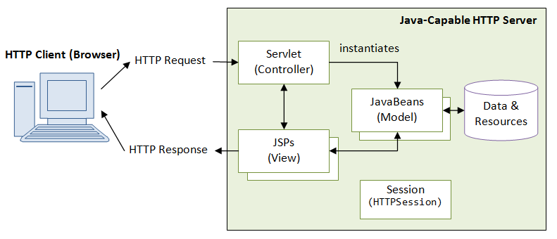
Technical Architecture:

Slide 9
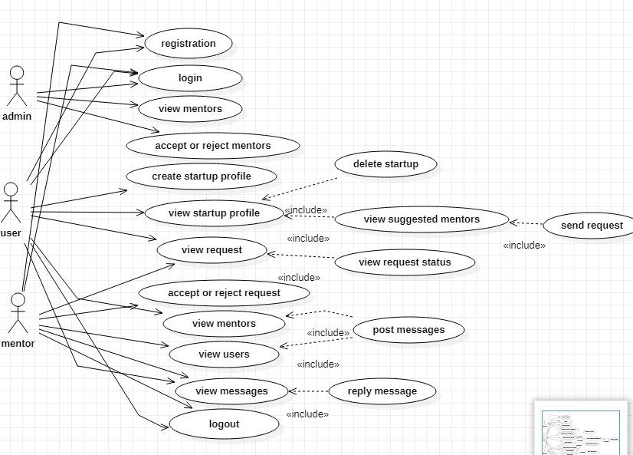
USE CASE DIAGRAM

Slide 10
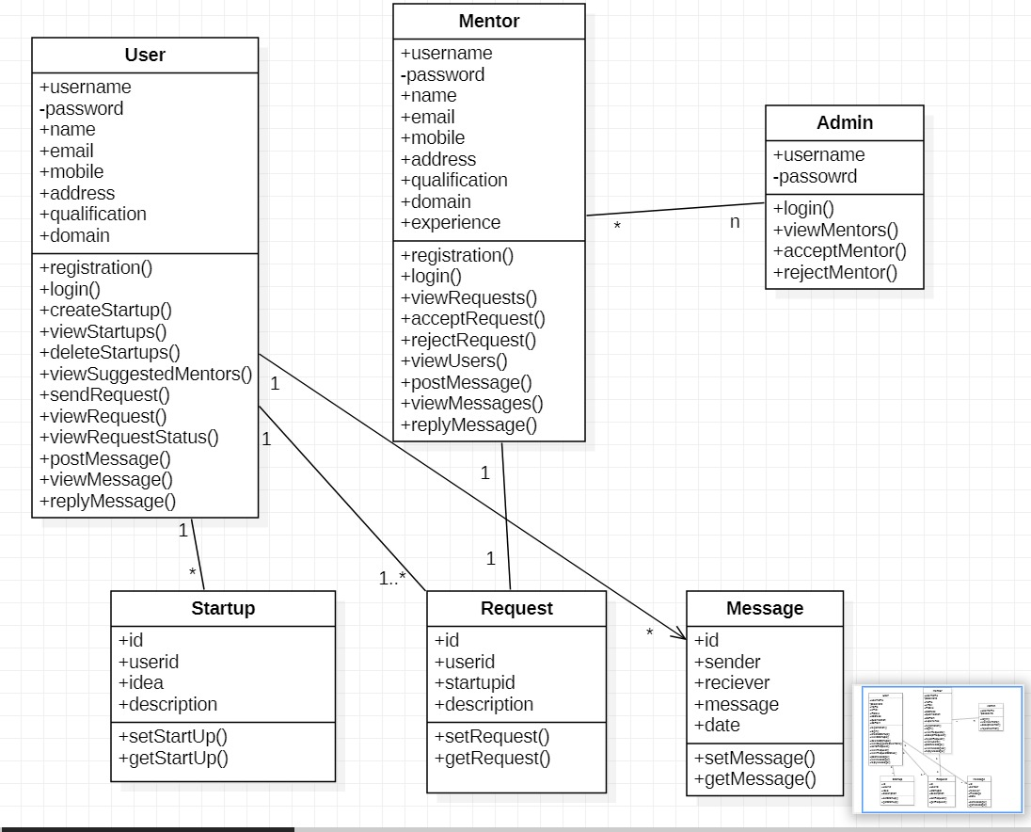
CLASS DIAGRAM

Slide 11
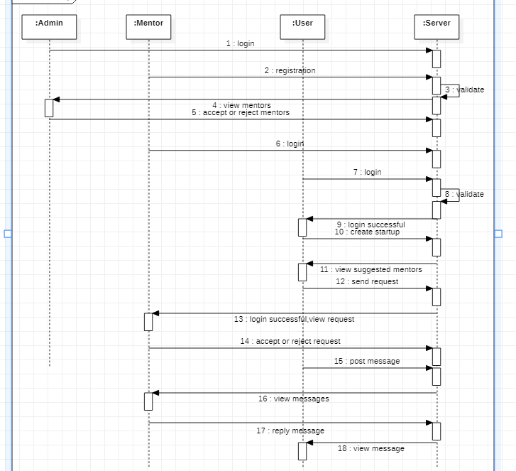
SEQUENCE DIAGRAM

Slide 12
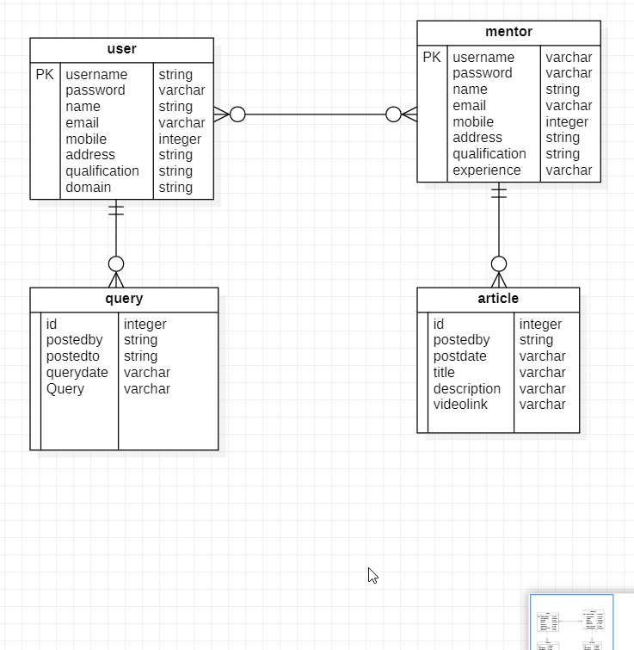
ER DIAGRAM

Slide 13
MODULES:
Admin
The module consists of View mentors and Activates or deactivates mentor accounts.
User
The module consists of Search Mentors, Send Query, View Query’s, Delete Query’s, View Articles.
Mentor
The module consists of Post Articles, View Articles, Delete Articles, View Query’s, Reply Query’s.

Slide 14
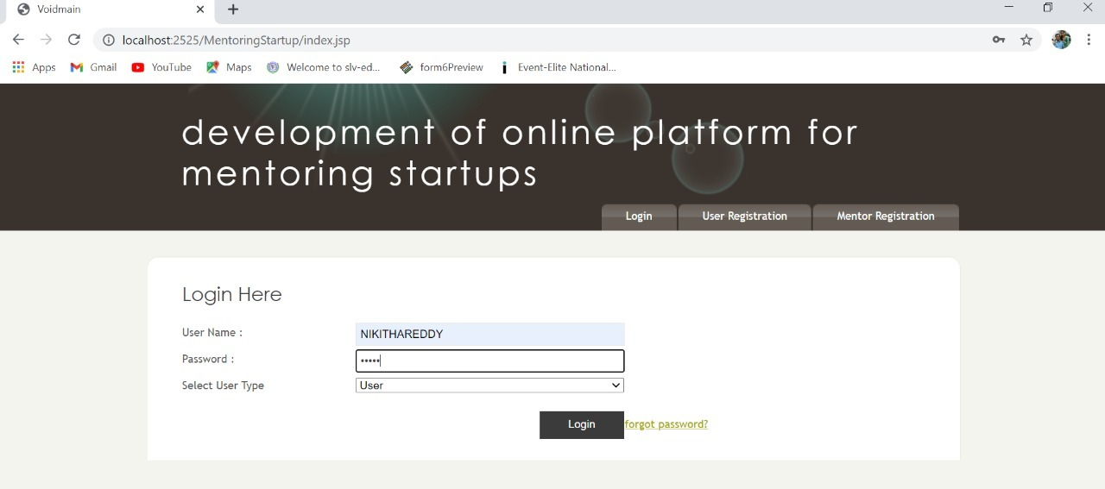
OUTPUT SCREENS
Login page:

Slide 15
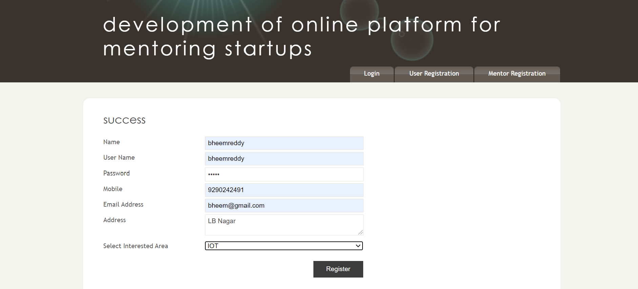
User Registration:

Slide 16
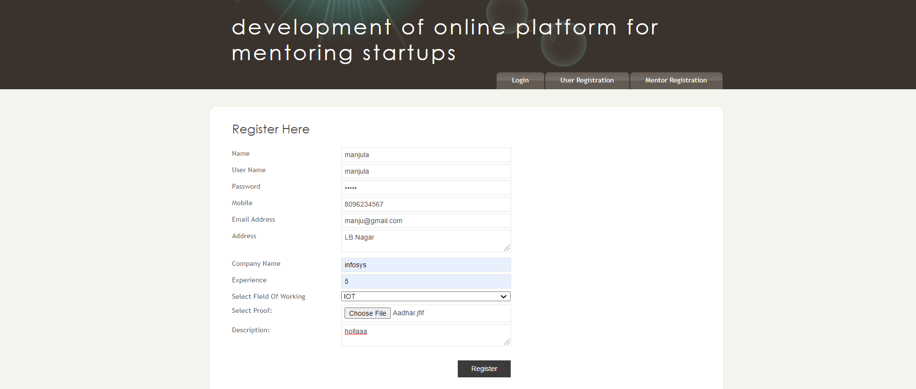
Mentor Registration :

Slide 17
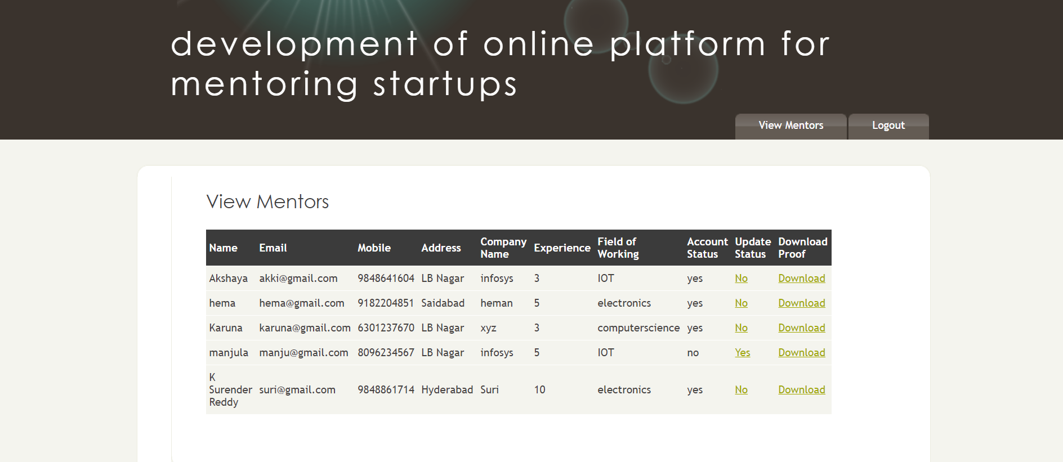
ADMIN-VIEW MENTOR :

Slide 18
Test case | Input | Expected output | Actual output | Result
Admin page | Admin can view all the mentors here | Mentor accepted | Can accept mentors | success
Admin page | Views mentors | Mentor rejected | Can reject mentors | success
Test case
Input
Actual action

Slide 19
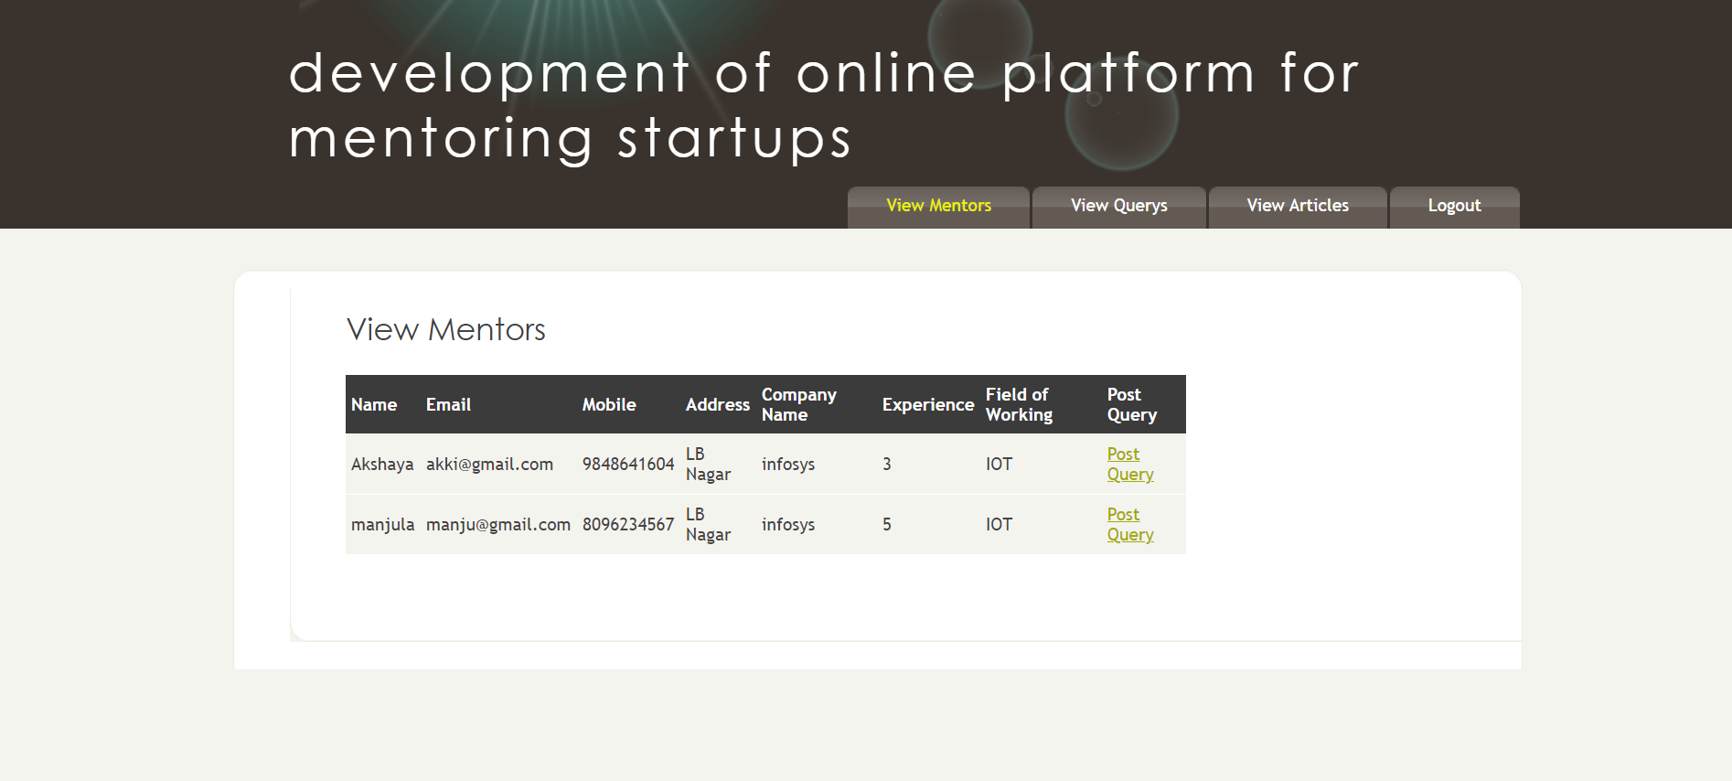
User – view mentor :

Slide 20
Test case | Input | Expected output | Actual output | Result
User page | user can view all the mentors here | User post query’s | Mentor details are viewed and post query’s | success
User page | If there are no mentors registered | No mentors visible | No mentors visible | Success

Slide 21
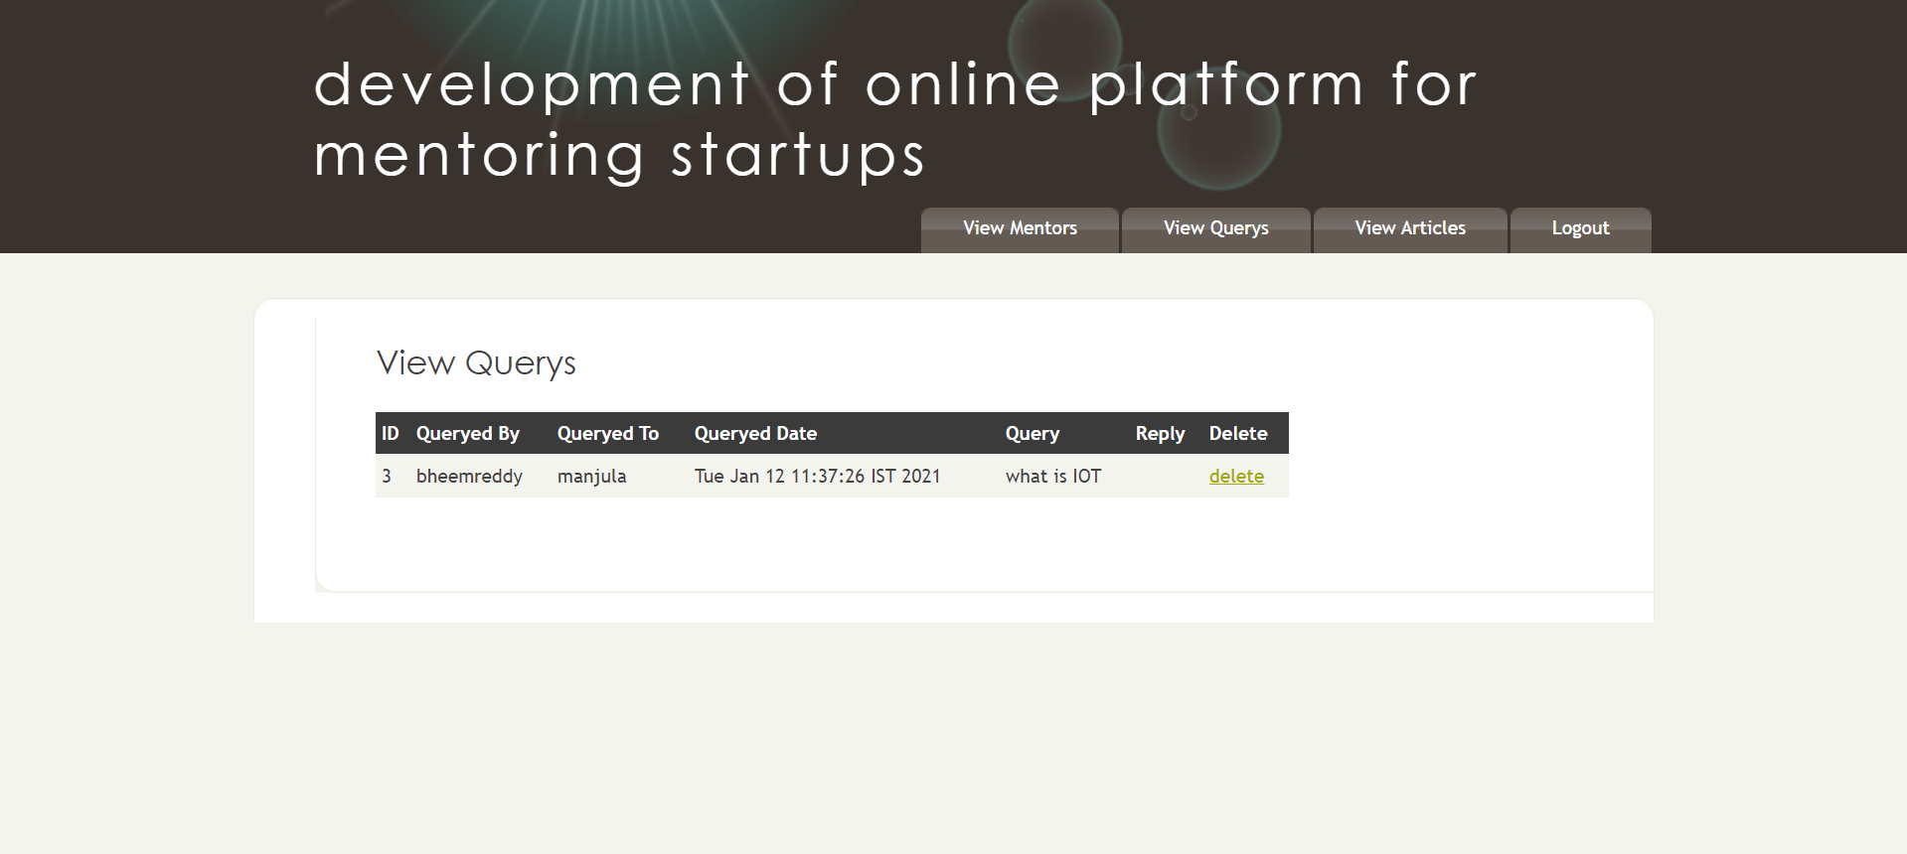
User-view query :

Slide 22
Test case | Description | Expected output | Actual output | Result
View query | user can view query’s posted by him | Delete or view query’s | User can view and delete his query’s | success
View query | If there no query’s posted | No query’s visible | no query’s visible | success

Slide 23

User-view article:

Slide 24
Test case | input | Expected output | Actual output | Result
View article | user can view articles | View articles | View articles , watch if any videos posted | success
View article | If no articles posted | No article visible | No articles visible | success

Slide 25
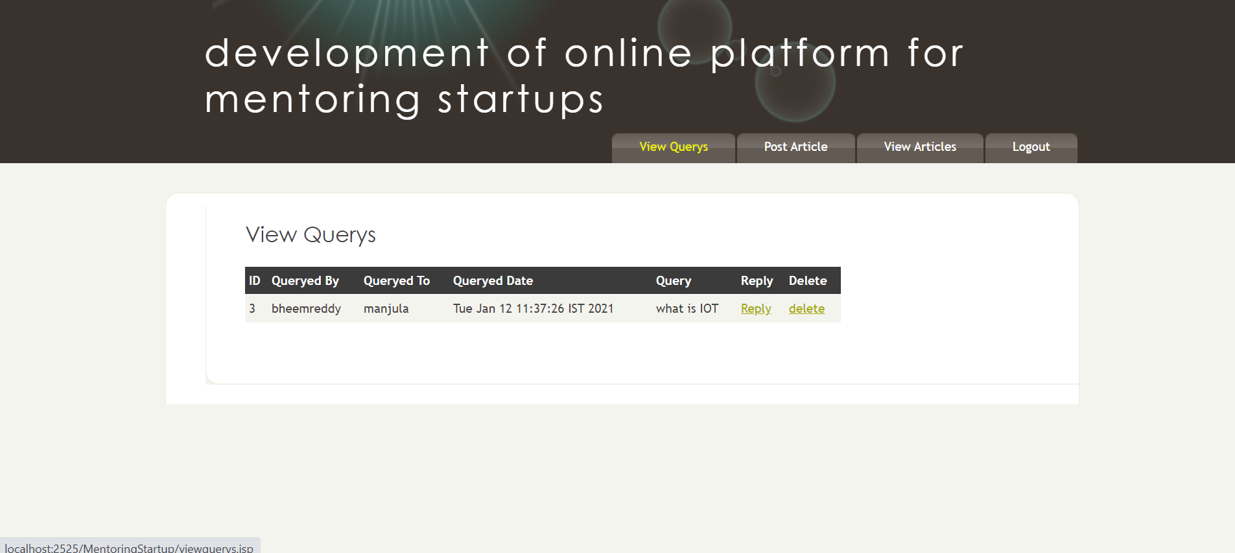
Mentor-view query’s:

Slide 26
Test case | Input | Expected output | Actual output | Result
View query | mentor can see query’s | Reply and delete query | Can reply and delete query | success
View query | If no query is posted | No query is visible | No query is visible | success

Slide 27
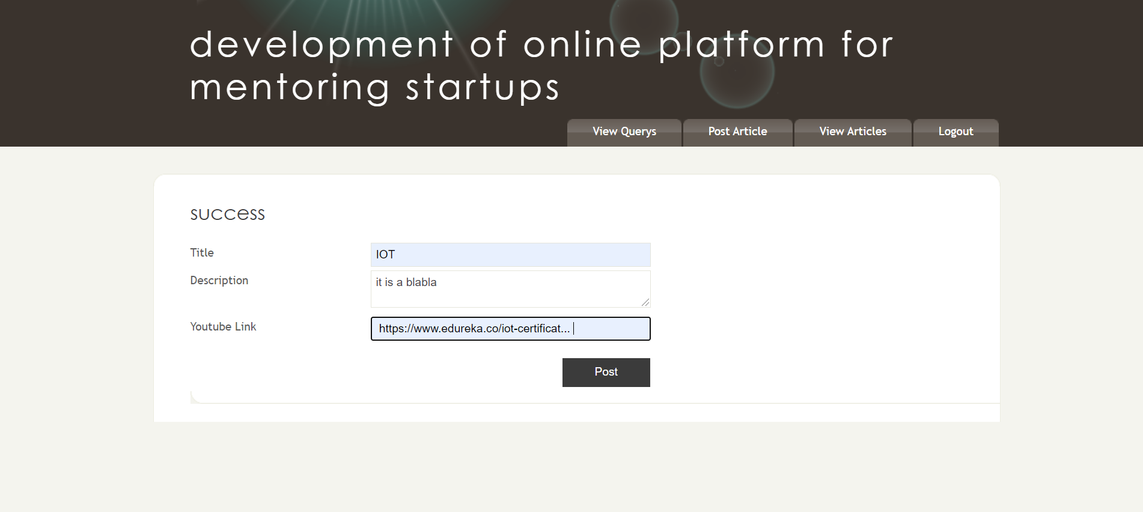
Mentor-Post article:
Test case | Input | Expected output | Actual output | Result
Mentor page | mentor can post article | Article gets posted and success displays | Article gets posted ,success message | success

Slide 28
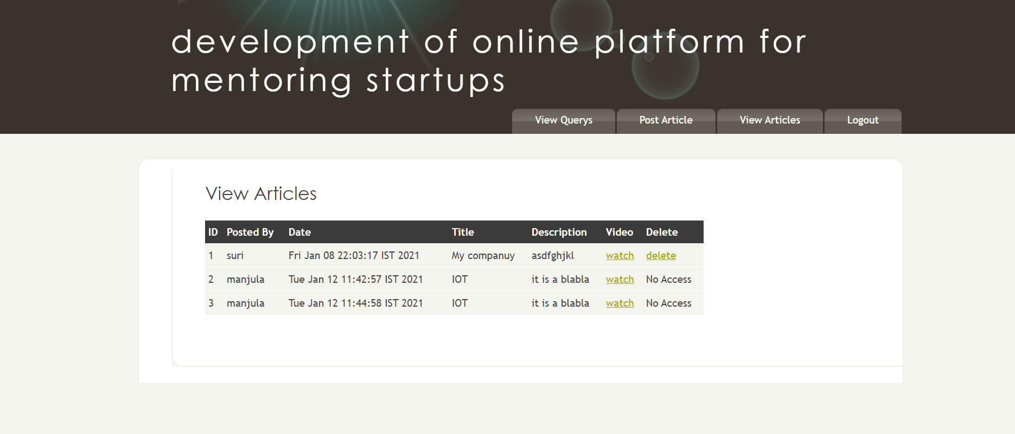
Mentor-view articles:

Slide 29
Test case | input | Expected output | Actual output | Result
View article | mentor can post article | Article gets posted and success displays | Article gets posted ,success message | success
View article | Mentor can delete their articles | Article deleted | Article deleted | success

Slide 30
CONCLUSION
The proposed application offers startups, entrepreneurs and accelerators a platform for mentoring and coaching success.
Bring your startups and entrepreneurs closer together with the mentoring platform.
Connect experienced mentors with up and coming entrepreneurs and startups.

Slide 31
THANK YOU
Notes:
31

